Slide 1
Hotel Revenue and Guest Insights Dashboard
Turning hotel booking data into clear, explainable decisions
Mohammed Abudagga - 202210006
Supervised by Dr. Wasef Matar
307498 Graduation Project · Business Intelligence and Data Analytics · University of Petra

Slide 2
1
Independent hotels have data — but not always usable insight
Booking files pile up, while pricing and occupancy decisions are still often made by instinct
1
Data is available but difficult to interpret
2
Existing BI options do not fit the user
Booking exports contain useful information about demand, cancellations, guests and channels, but a small hotel manager may not have the time or analytics background to clean and analyze it.
Enterprise tools can be expensive, generic or too complex for a small property. HotelBI focuses on the hotel metrics a manager actually needs and explains why each alert is triggered.
Both problems lead to the same gap: data exists, but it is not turned into quick decisions.
This project closes that gap with one CSV upload, hotel-specific dashboards, rule-based alerts and short-term forecasting.

Slide 3
2
The data, and why this one
Hotel Booking Demand — Kaggle / Mostipak
119,390
32
2
2015–2017
raw booking records
source fields
hotel types · City Hotel and Resort Hotel
booking period represented in the source data
Four requirements — this dataset supports the project well
Channel information — market segment and distribution channel
Booking behavior — cancellations, lead time, stay length and repeated guests
Hotel performance — ADR and room-type information

Slide 4
3
The cleaning decisions that mattered most
The goal was to make uploaded booking data consistent before calculating any insight.
Missing values had to be handled deliberately
Confirmed / Cancelled standardized status
YYYY-MM-DD standardized website date format
The source contains fields with very different levels of missingness. Company and agent identifiers are often empty, while only a few records are missing children or country.
Cleaning is part of the product, not a separate analyst task. The manager should upload a file and receive either a clean result or a clear validation message.
112,593 missing company values
16,340 missing agent values
Booking fields needed standard formats
Dates, status values and channel labels have to be standardized before the dashboard can safely group or compare records.

Slide 5
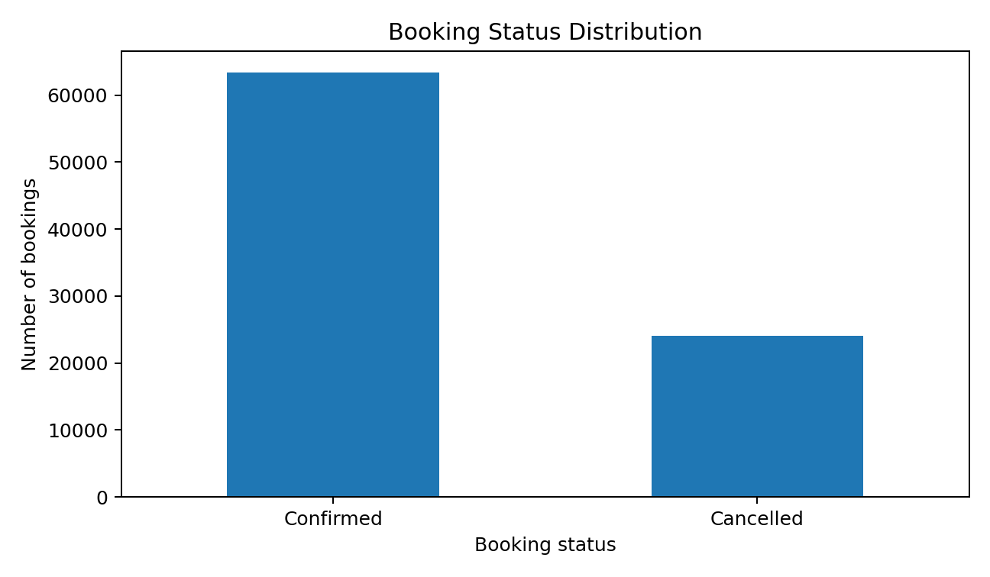
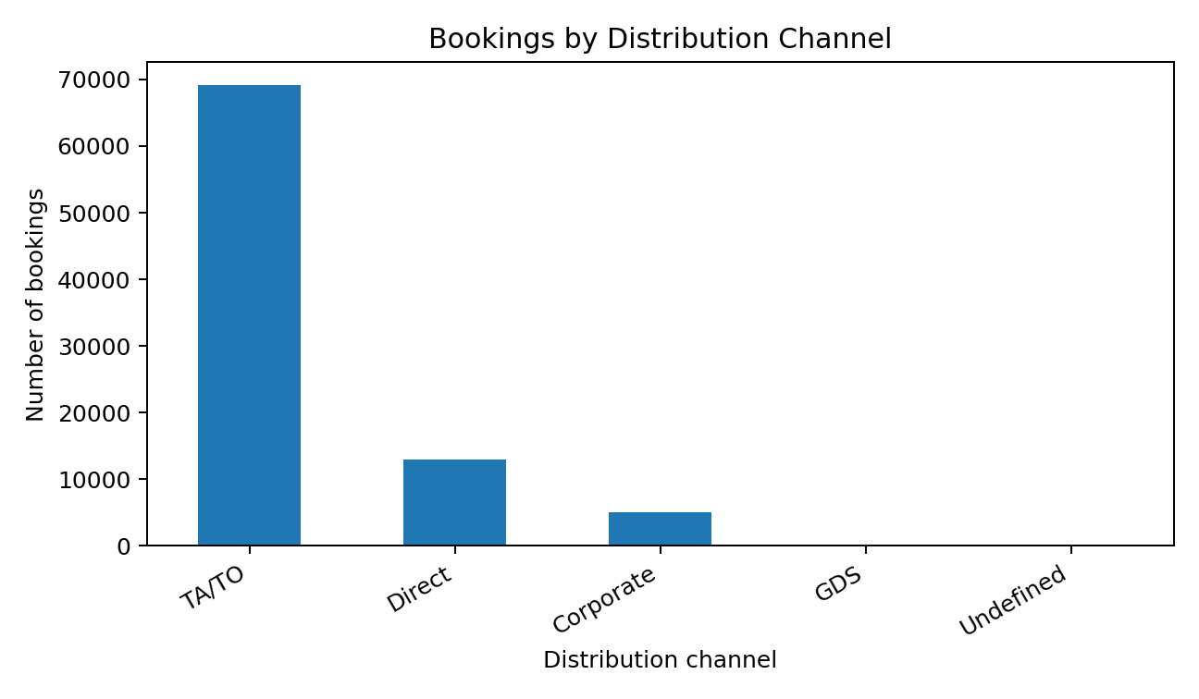
4
What the booking data actually looks like
37.0% of source bookings are cancelled
TA/TO is the dominant distribution channel
Left: cancellation is large enough to affect revenue planning. Right: channel concentration makes channel performance a useful management view.

Slide 6
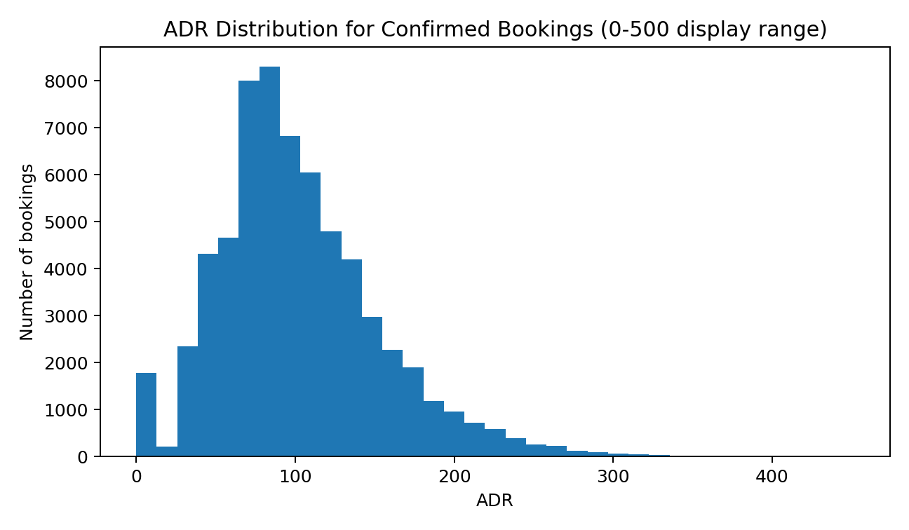
5
Why one metric is not enough
Price, demand and booking behavior answer different management questions
ADR has a mean of about 101.83 and a median of 94.58 in the source dataset.
Occupancy alone cannot explain whether a hotel is earning enough from the rooms it sells. HotelBI therefore presents several measures together:
OCCUPANCY
how much capacity is being used
ADR
Average Daily Rate distribution

Slide 7
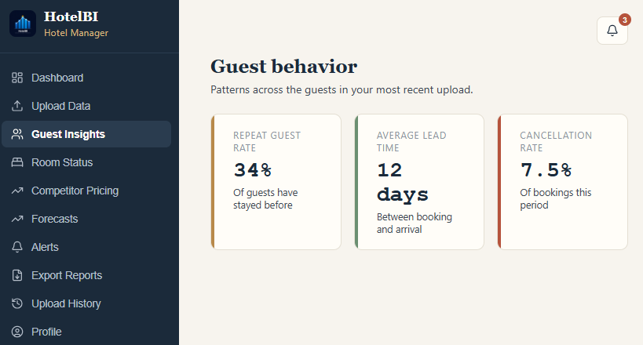
6
Guest behavior — and the line that matters
3.2%
69 days
repeated guests in the source data
median booking lead time
37.0%
source cancellation rate
Guest behavior is not just descriptive. It helps a manager understand how early guests book, how much cancellation risk exists, and how much business comes from returning guests.
119,390 bookings analyzed for behavior and demand patterns

Slide 8
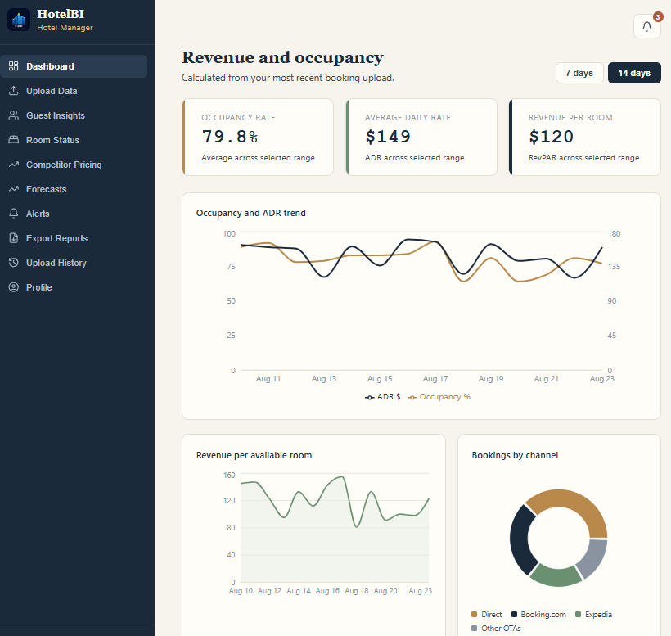
7
The dashboard: one view of hotel performance
Built around the questions a hotel manager checks repeatedly
The manager can switch between short date ranges and see the headline metrics recalculate.
CSV
The dashboard combines revenue performance with booking-channel context so the manager can move from a raw file to an understandable operating picture.
one upload starts the analysis
3
7–14 days
core performance metrics
short-term forecast window
Occupancy, ADR and RevPAR across the selected period

Slide 9
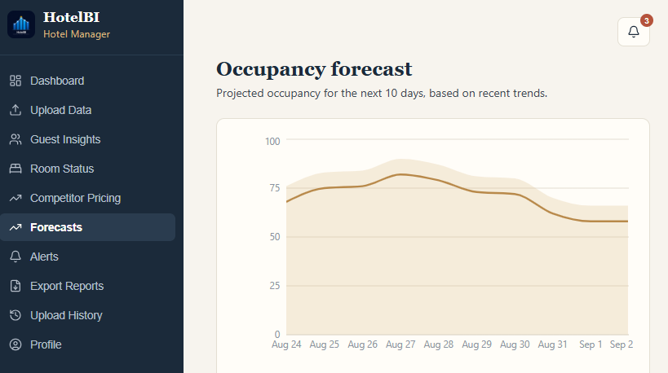
8
Forecasting: intentionally simple and explainable
Moving averages for a short 7–14 day planning window
Method | Median MAE | Beats naive
Naive (repeat last value) | 79.6 | —
Moving average | 75.3 | —
Holt-Winters | 73.0 | 156 of 300 (52%)
The current prototype uses simple moving averages rather than a machine-learning model. That choice matches the project goal: keep the result understandable and avoid claiming precision the prototype cannot support.
The limitation is also clear: accuracy is expected to fall as the forecast window becomes longer.
Forecasting is used as a directional planning aid, not presented as a black-box prediction.

Slide 10
9
The rule engine, designed to explain every alert
alert = metric crosses a configured threshold + plain-language reason
Low occupancy, competitor rate gaps and cancellation spikes can be represented as threshold rules. Administrators can adjust the platform defaults, while managers see the reason an alert fired.
Policy | Stockout weeks | Mean stock held
Derived (ABC/XYZ + forecast error) | 419 | 378
Uniform four-week cover | 415 | 562.7
3
example threshold types
No black-box recommendation — the trigger is visible to the user.
That transparency is a core design requirement of HotelBI.
Low occupancy · competitor rate gap · cancellation spike
Rules are configurable, so the system can be refined without replacing the whole analytics approach.

Slide 11
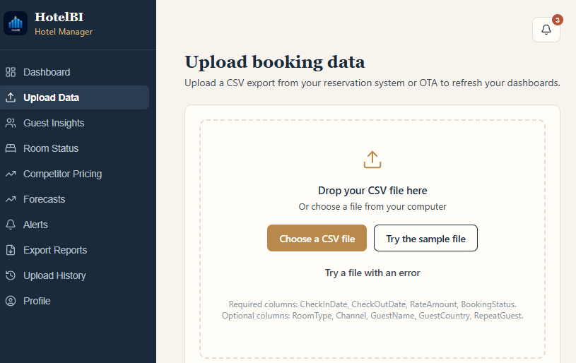
10
HotelBI
What a hotel manager actually does with the system
Live demo
1. Log in as Hotel Manager
Open the revenue and occupancy dashboard.
2. Upload the booking CSV
The file is validated and standardized.
3. Open Guest Insights / Forecasts
Review behavior and the short-term trend.
4. Open Alerts
See the threshold and the reason behind each recommendation.
hotelbii.netlify.app

Slide 12
11
What we built
119,390
Real booking records used for development and analysis.
The limitation
The current website is a front-end prototype. Uploaded data, alerts and account changes do not persist after refresh, and the dashboard occupancy trend is still illustrative rather than calculated from a complete room-inventory calendar.
37.0%
Cancellation rate in the source data — a major planning signal.
7–14 days
The forecasting window is intentionally short and explainable.
Thank you — questions?

